Slide 1
Systemic Harmonization and Interoperability Enhancement for Laboratory Data (SHIELD)
February 9, 2023
Overview Briefing
Riki Merrick

Slide 2
Background
WHERE WE HAVE BEEN
Clinical laboratory data – orders, results, and interpretations – are among the most important types of data for clinical care, public
health, and the development of drugs and medical devices. However, because of non-standardized coding practices across our national landscape, laboratory data is easy to transmit but incredibly difficult to curate and analyze. To solve this problem, SHIELD was created.
Multi-agency workshops were convened to brainstorm ways of improving IVD test
data quality
FDA performs a “pressure test” for a SHIELD solution and generates real world data (RWD) for the extent to which current health data standards integrate into information systems
SHIELD forms eight formal committees which begin to produce documentation regarding harmonization of laboratory data standards
Today:
The Need for SHIELD is Identified
SHIELD Begins Pilot Site Evaluation
The SHIELD Committees Form
2015
2019
2020
Honoring Mike’s Legacy
The foundation that Mike Waters and SHIELD’s original members worked so hard to establish has begun to pay dividends. A strategic planning effort is underway to begin the growth and development of SHIELD. In addition, SHIELD is looking towards forming formalized teams to build optimal solutions.
2018
2020
2021
SHIELD is Founded
The Pandemic Hits
Roadmapping & Assessments Begin
Mike Waters formalizes and founds SHIELD to bring together stakeholders and perspectives from across agency and industry
As COVID-19 began to spread and testing became more widely-available, the need for laboratory interoperability became increasingly apparent
SHIELD’s volunteers begin drafting a comprehensive roadmap plan for socialization with external partners
Current Activities:
Landscape Assessment
Solution Testing
Strategic Planning
Stakeholder Engagement
Notes:
Transition: “I believe that Mike would be incredibly proud of the accomplishments we’ve made already and the direction that we are currently working towards, but before I tell you too much more about where SHIELD is headed, I want to provide you with a little bit more information about the problems that our industry is facing and our team’s findings so far…”

Slide 3
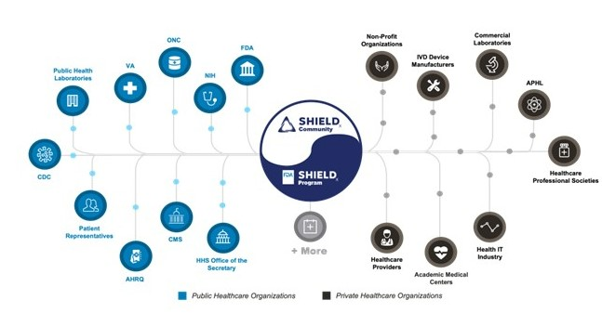
Bridging the Public-Private Gap
WHERE WE ARE
Solving these issues will be no small feat and requires collaboration across government regulatory bodies, public health laboratories, private healthcare systems, and In-Vitro-Diagnostic (IVD) device manufacturers. That’s where SHIELD comes in.
Notes:
Transition: Bringing together passionate volunteers from across the healthcare ecosystem has proven to be a great success so far. We've worked to better understand the full scope of issues but most importantly, we’ve gained consensus on a way-forward. The pandemic certainly put a more prominent spotlight on the issues we are still having with laboratory data interoperability and pushed this group to put together a roadmap and as first steps have evaluated a few pilot sites and created a LIVD file to support the COVID-19 response, which are great first steps, but now is the time for SHIELD to grow into the full-scale and radically transformative operation that Mike Waters believed that it could be.
g

Slide 4
WHERE WE’VE BEEN
The Problem - Current State
Hospital A
Laboratory 1
Public Health Reporting
HIE & Hospital Data Exchange
Secondary Uses (e.g., Research, Analytics)
Hospital B
Laboratory 2
Notes:
But first let’s make sure we all understand the current state – where it is electronic. There are certainly still MANY places that use paper and that needs to be addressed as well. In this diagram you will see red bursts – these identify places in the current state, where data is manipulated, which takes resources and provides opportunity for the introduction of errors. Healthcare providers order tests from the lab – in #1 it is their in-house laboratory, in number 2 they use a reference lab. The labs perform the test using an IVD test kit and instrument and provide the result back to the provider. Even with an in-house lab, depending on the size of the healthcare system, data may need adjustment.
Review of data received from outside labs is even more common to need curation before it can be safely integrated into the EHR-system; if it is even done.
Later provider 1 orders a follow up test from the reference lab.
When the result gets back data review is needed to determine if enough information is provided in the lab report to know, if the result can be considered equivalent to the in-house result and used in the patient’s flowsheet or for decision support. For example during the early days of COVID when a patient had an existing COVID test result it could be used to triage for provider PPE use and patient handling, if the test is considered equivalent to the in-house testing: for that you would have to know the test method, preferably to the level of test kit / instrument used and the specimen type.
Currently we have standards and defined terminologies for reporting to Public Health, but not all labs encode the same test the same way, so the public health agencies also have to curate data.
Labs may also report results for use in clinical trials or research, but there the requirements differ for each study making lab data not comparable across studies (and sometimes even within the same study from different labs).
Exchanging data between providers either directly or via HIEs also suffers from lack of standardization resulting in additional data curation.

Slide 5
WHERE WE ARE HEADED
Future State
Lab Orders Interface (LOI)
Electronic Laboratory Reporting (ELR)
Lab Results Interface (LRI)
Hospital A
Laboratory 1
Public Health Reporting
HIE & Hospital Data Exchange
LIVD
IVD Manufacturers
Laboratory Information Data Repository (LIDR)
IVD Data Store
LOI
LRl
Hospital B
Laboratory 2
Secondary Uses (e.g., Research, Analytics)
Notes:
This shows the updated healthcare ecosystem after implementation of the SHIELD Strategic Plan.
Providers will still order tests from their respective laboratories, but these labs can now use the Laboratory Interoperability Data Repository (LIDR).
When a new test is brought to market the IVD manufacturer provides all required data to the FDA and assigns a Unique Device Identifier (UDI) to the test. All related data about the test (the UDI, what samples can be tested, what exactly is the being looked for, what method being used on what instrument and what are the expected results and so on) including the representation in standard terminologies like LOINC and SNOMED is submitted to LIDR using an industry developed and supported SHIELD standard called LIVD. SHIELD will provide tooling to the labs to use LIDR to properly set up the new test in their LIS. The IVD test will use a SHIELD standard called IHE LAW (Laboratory Analytical Workflow) to report the results back to the LIS which in turn will report the results to the EHR at the provider.
Using SHIELD standards – for example Laboratory Orders Interface (LOI) and Laboratory Results Interface (LRI) for the transactions between the EHRs and the LIS- the data is exchanged without need for additional curation and enough information to be safely integrated into the patient record as discrete data.
Lab results for new tests are also reported to the IVD Data Hub, providing Real World Evidence (RWE) for post-market studies.
Labs can still directly report to public health and research, but with a higher level of standardization or there is also the potential of reuse of the hub as the data source for these and other use cases.
Well curated data in both providers’ EHRs can also be exchanged with less risk of data fidelity loss.

Slide 6
SHIELD Activity Now
Community:
Proposed Charter
Updated Roadmap document and related Adjudicated comments spreadsheet
Form Steering Committee – approved initial composition on next slide
Get Updates from FDA funded BAA projects
FDA:
Created Program – leads: Keith Campbell and Victoria Derbyshire
3 BAA projects:

Slide 7
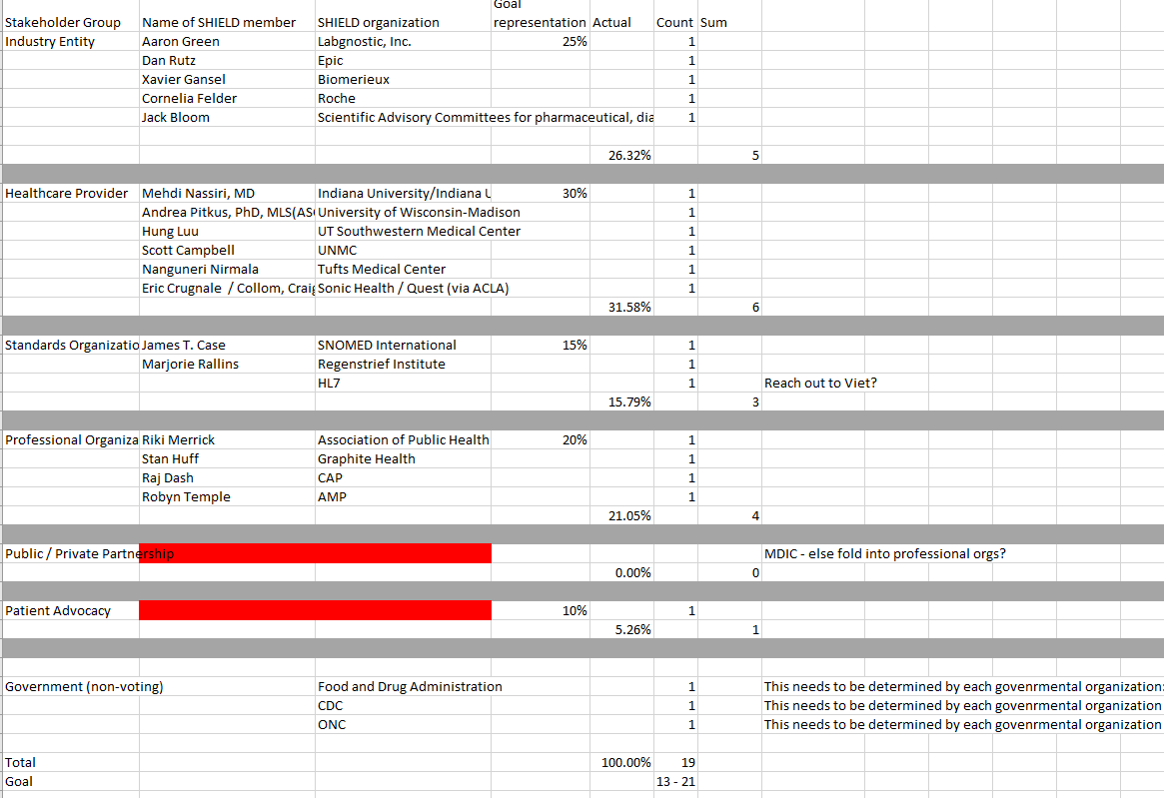
Steering Committee

Slide 8
Call Cadence
ALL-SHIELD Call is once a month (normally 4th) Tuesdays 12 – 1 PM ET
February 28th
March 28th
April 25th
Add interim calls for specific project updates – every 2nd Tuesday starting in December
February 14th – FDA BAA CAP work
March 14th – FDA BAA Deloitte work
Steering Committee calls – doodle poll sent today – earliest would be third week in February

